Slide 1
Two-Way ANOVA
MSDS 660

Slide 2
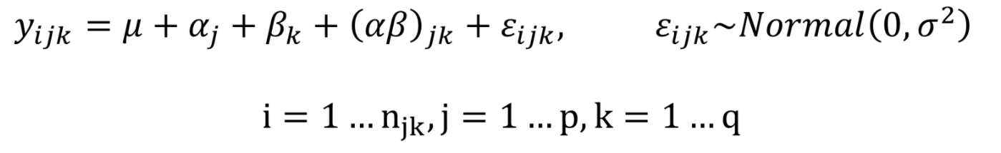

Statistical Model
More than one predictor variable, and perhaps an interaction between the predictors:
Predictor one is α and predictor two is $β$ and they interact (α $β$)
There are ‘p’ groups for predictor one and ‘q’ groups for predictor two

Slide 3
Example
Study on memory: How many words, on average, do people recall when given certain processing tasks?
Counting and rhyming are lower processing tasks, so the hypothesis was that this group would recall fewer words than others
100 subjects were split into 5 recall groups:
“Counting”: subjects counted how many letters were in each presented word
“Rhyming” subjects thought of words that rhymed with each presented word
“Adjective”: subjects thought of an adjective that could be used to modify each presented word
“Imagery”: subjects were told to form vivid images of each word
“Intentional”: subjects were told to memorize the word for later recall
The subjects were also classified as “young” or “old”

Slide 4
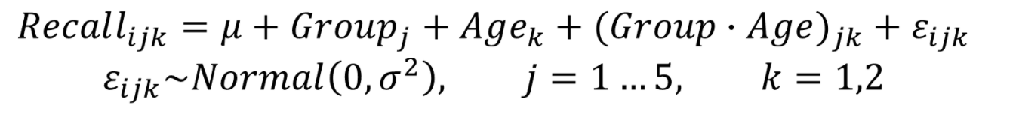
Example – Model
Here’s the ANOVA model:

Slide 5
Model in R
fit <- aov (y ~ A * B * C, data = dt)
fit <- aov (y ~ A + B + C + A:B + A:C : B:C + A:B:C, data = dt)

Slide 6
Interactions
When an interaction is present, the impact of one factor depends on the level of the other factor
Interaction affects are evident by a low p-value (less than 0.05)
They will show that at least one factor level is having an interaction on another factor level and giving an interaction
With many levels and factors post hoc analysis can quickly become very confusing…
So interaction plots can help

Slide 7
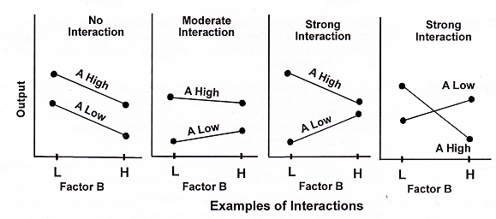
Which plots show strong interaction effects?

Slide 8
Demos

Slide 9
In Class Assignment
Post your In-class_Food_Project.R file to the Week 5 discussions and state which (if any) interactions are significantly different.

Slide 10
Homework
Multi -way ANOVA on another dataset. You can use the ‘engineer.csv’ dataset on Worldclass week 5 if you don’t want to find a different data set
Use a template from the in class demos or in class group assignment
Construct some box plots and plot designs
Do a 2-way ANOVA fit, an interaction plot, AND interpret the results
Check the assumptions
Write an APA paper – explain it like someone has never heard of statistics

